Slide 1

Planning Network-Based Firewalls
Team Members:
Tahseen Begum – 2010030168
E.Pravallika – 2010030046
Keerthana Pulugam - 2010030445

Slide 2
Outline
Abstract
Introduction
Implementation Flow Chart
Literature Survey
Aim
Objectives
Outcomes of the work
Features
Methods
Result
Conclusion

Slide 3
ABSTRACT
Network firewalls are security devices used to stop or mitigate unauthorized access to private networks connected to the Internet, especially intranets. The only traffic allowed on the network is defined via firewall policies – any other traffic attempting to access the network is blocked.

Slide 4
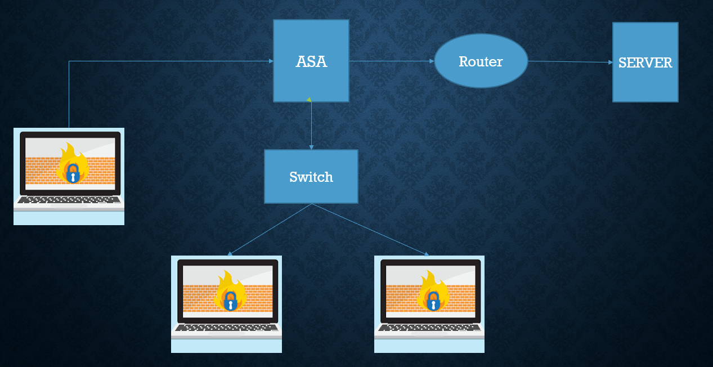
Implementation Flow Chart

Slide 5
INTRODUCTION
Firewall is a network security device, either hardware or software-based, which monitors all incoming and outgoing traffic, and based on a defined set of security rules it accepts, rejects, or drops that specific traffic.

Slide 6
LITERATURE SURVEY
S.NO | Author | Title | Publishing date | About
1 | Habtamu Abie | An overview of firewall Technologies | December 2020 | This article provides an overview of firewall technologies. Firewall technologies, network security, access control, security policy, protective mechanisms
2 | Ajay Yadav | Network Design: Firewall | August 4, 2020 | This article provided an in-depth overview of firewalls and their roles in protecting the corporate network. There are four main types of firewalls: packet-filtering, application gateways, circuit-level gateways and other firewalls.

Slide 7
OBJECTIVES
A firewall is anything, hardware or software, that monitors the transmission of packets of digital information that attempt to pass the perimeter of a network firewall perform two basic security functions: 1. Packet filtering 2. Application proxy

Slide 8
FEATURES
•Logging unauthorized accesses into/out of a network •Providing VPN link to another network •Authenticating users •Shielding hosts inside the network from hackers •Caching data •Filtering content considered inappropriate or dangerous 8 Firewall

Slide 9
METHODS
Identify security requirements for your organization.
Define an overall security policy.
Define a firewall philosophy.
Identify permitted communications.
Identify the firewall enforcement points.

Slide 10
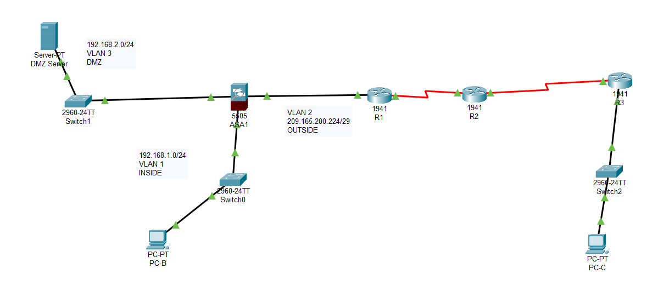
RESULT

Slide 11
CONCLUSION
A firewall can simplify the task of protecting your site from unwanted intrusions. Without a firewall, each system that is attached to the internet has to be made secure and must provide a uniform level of security so that one machine cannot compromise another.

Slide 12
THANK YOU

